Slide 1
Create and Modify Queries
Microsoft Access 2013
Lesson 7

Slide 2
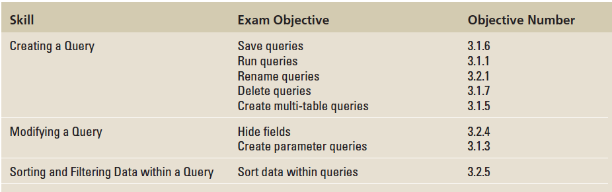
Objectives

Slide 3
Step by Step: Create a Simple Query
GET READY. Before you begin these steps, be sure to LAUNCH Microsoft Access.
OPEN the Northwind file from the data files for this lesson.
SAVE the database as NorthwindXXX (where XXX is your initials).

Slide 4
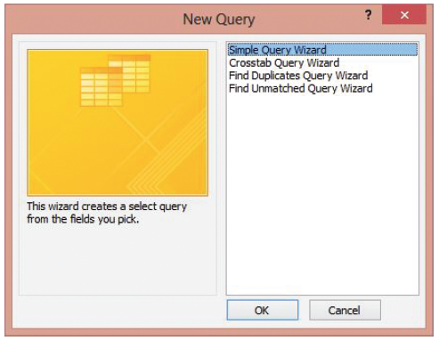
Step by Step: Create a Simple Query
On the CREATE tab, in the Queries group, click the Query Wizard button. The New Query dialog box appears, as shown at right.

Slide 5
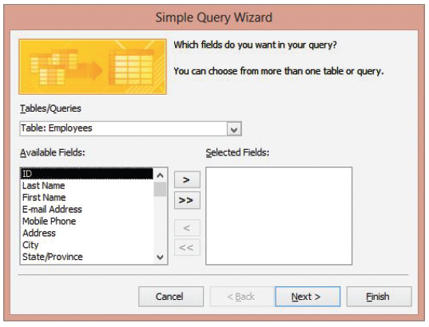
Step by Step: Create a Simple Query
Click Simple Query Wizard and then click OK. The Simple Query Wizard appears, as shown at right.

Slide 6
Step by Step: Create a Simple Query
In the Tables/Queries drop-down list, Table: Employees should be selected by default. If it is not, select it.
Under Available Fields, double-click Last Name, First Name, E-mail Address, Mobile Phone, and Position to move them to the Selected Fields box.
Notes:
Take Note: To remove a field from the Selected Fields box, double-click the field. This moves it back to the Available Fields box.

Slide 7
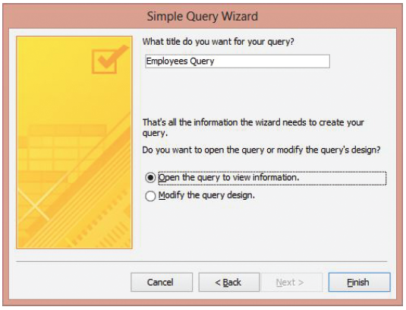
Step by Step: Create a Simple Query
Click the Next > button. The second screen in the Simple Query Wizard appears, as shown at right.
Name the query Employees Contact Query. Open the query to view information should be selected.

Slide 8
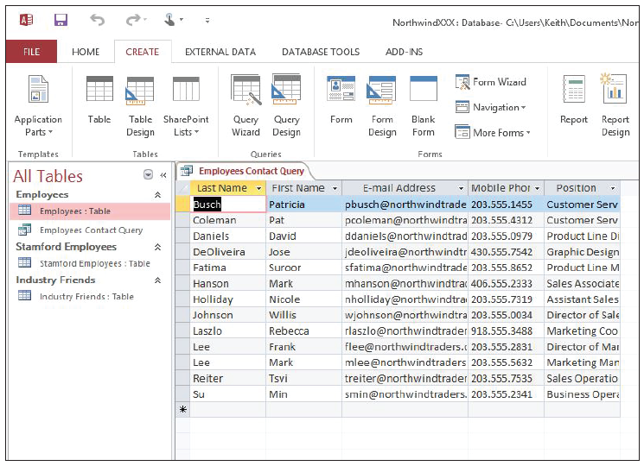
Step by Step: Create a Simple Query
Click the Finish button to accept the default selection and complete the query. The Employees Contact Query is displayed, as shown at r ight. The results show all of the records, but show only the five fields that you specified in the Query Wizard.
Click the Close button on the Employees Contact Query window to close the query.
Notes:
Another Way: You can also delete a query or any other object by right-clicking it in the Navigation Pane and choosing Delete from the shortcut menu that appears, or clicking the object and just simply pressing the Delete key on the keyboard.

Slide 9
Step by Step: Create a Simple Query
In the Navigation Pane, double-click the Employees Contact Query to run it. The query results are displayed in Datasheet view.
Click the Close button on the Employees Contact Query window to close the query.
In the Navigation Pane, right-click the Employees Contact Query to select it.
On the shortcut menu that appears, click the Rename command.
In the query name box, key Employees Contact Info Query to rename it and press Enter. The query has been renamed.

Slide 10
Step by Step: Create a Simple Query
In the Navigation Pane, click the Marketing Employees query to select it.
On the HOME tab, in the Records group, click the Delete button arrow and then click the Delete command on the menu that appears.
Click Yes on the dialog box asking you if you want to permanently delete the Marketing Employees query. The query is now permanently deleted from the database.
PAUSE. LEAVE Access open to use in the next exercise.

Slide 11
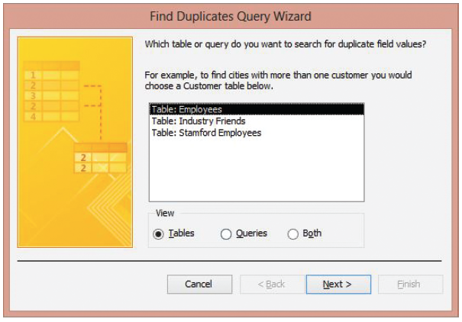
Step by Step: Create a Find Duplicates Query
USE the database that is open from the previous exercise.
On the CREATE tab, in the Queries group, click the Query Wizard button. The New Query dialog box appears.
Click Find Duplicates Query Wizard and then click OK. The Find Duplicates Query Wizard appears, as shown at right.

Slide 12
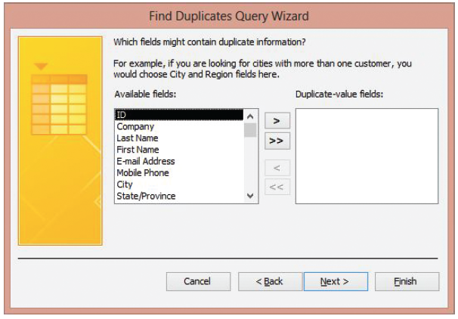
Step by Step: Create a Find Duplicates Query
Click Table: Industry Friends and then click Next >. The next screen in the Find Duplicates Query Wizard appears, as shown at right.
Double-click Last Name, First Name, and E-mail Address to move them to the Duplicate-value fields box. These are the fields that you think may include duplicate information.

Slide 13
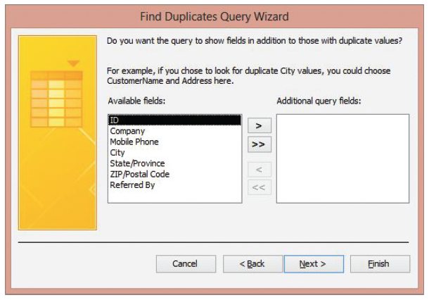
Step by Step: Create a Find Duplicates Query
Click Next > to display the next screen in the Find Duplicates Query Wizard, shown at right. This screen asks if you want to show other fields of the duplicate record besides just the ones with the duplicate data.
Double-click Company and Referred By to move them to the Additional query fields box.

Slide 14
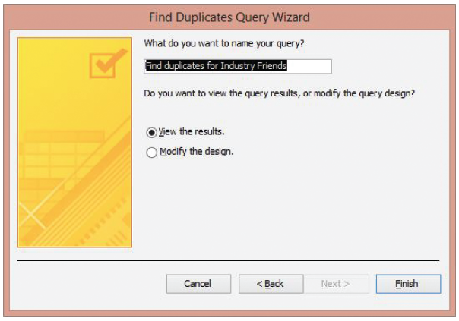
Step by Step: Create a Find Duplicates Query
Click Next > to display the final screen in the Find Duplicates Query Wizard, shown below.

Slide 15
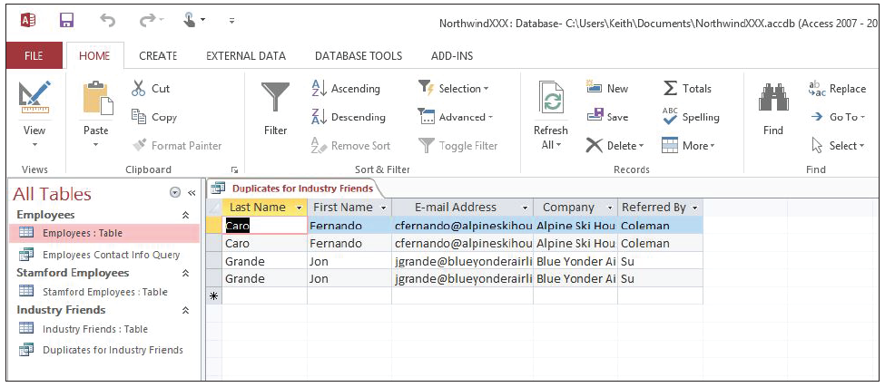
Step by Step: Create a Find Duplicates Query
Name the query Duplicates for Industry Friends and click Finish. The query showing duplicate records in the table is displayed, as shown below.
Click the Close button on the Duplicates for Industry Friends tab to close the query.
PAUSE. LEAVE Access open to use in the next exercise.

Slide 16
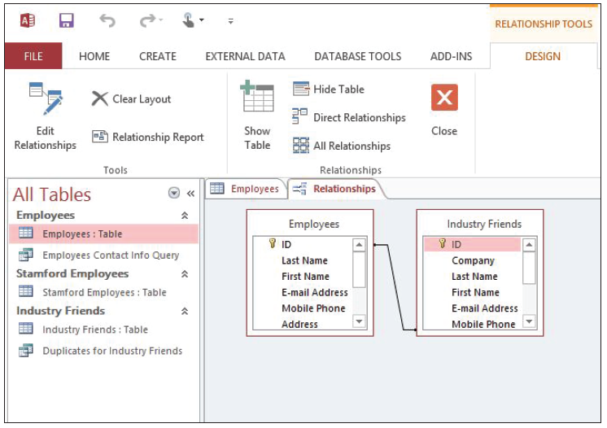
Step by Step: Create a Query from Multiple Tables
USE the database that is open from the previous exercise.
In the Navigation Pane, double-click Employees: Table to open the table.
On the DATABASE TOOLS tab, in the Relationships group, click the Relationships button to display the table relationship, as shown above. The Employees table has a defined relationship with the Industry Friends table as indicated by the relationship line connecting the two tables.

Slide 17
Step by Step: Create a Query from Multiple Tables
Click the Close button in the Relationships group on the Ribbon to close the Relationships window and click the Close button on the Employees tab to close the Employees table.
On the CREATE tab, in the Queries group, click the Query Wizard button to display the New Query dialog box.
Click Simple Query Wizard and then click OK to display the Simple Query Wizard.

Slide 18
Step by Step: Create a Query from Multiple Tables
In the Tables/Queries drop-down list, click Table: Industry Friends.
Under Available Fields, double-click Last Name, First Name, and Referred By to move them to the Selected Fields box.
In the Tables/Queries drop-down list, click Table: Employees.
Under Available Fields, double-click Position and then E-mail Address to move them to the Selected Fields box.

Slide 19
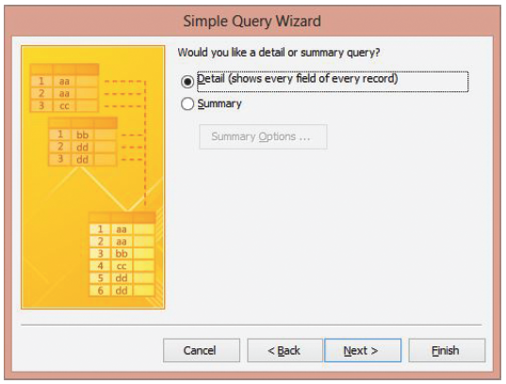
Step by Step: Create a Query from Multiple Tables
Click the Next > button to display the next screen, as shown at right. The Detail option should be selected by default.
Notes:
Cross Ref: If you want your query to perform aggregate functions like those used to sum or average data, you would choose a summary query. You will learn about aggregated functions in Lesson 12.

Slide 20
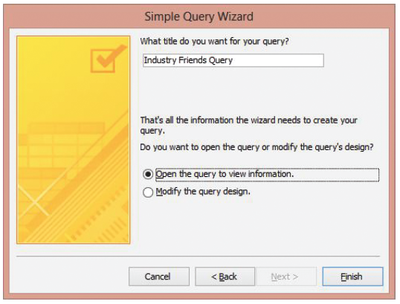
Step by Step: Create a Query from Multiple Tables
Click the Next > button to display the final screen, shown at right.

Slide 21
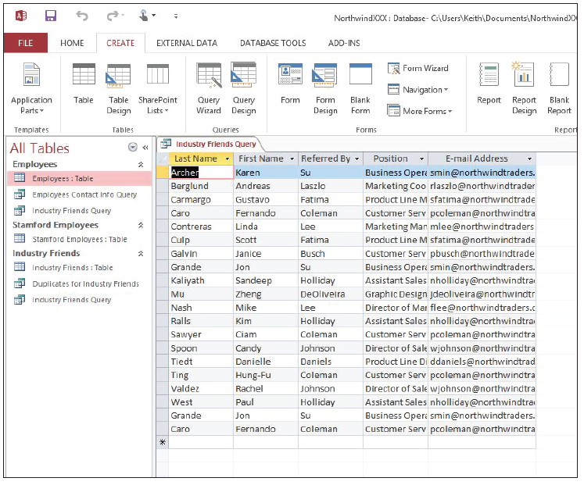
Step by Step: Create a Query from Multiple Tables
Click the Finish button to accept the default settings in this screen and display the query, shown at right. This query shows the name, position, and e-mail address of the employee who referred each industry friend.
Click the Close button on the Industry Friends Query tab to close the query.
PAUSE. LEAVE the database open to use in the next exercise.
Notes:
Cross Ref: You learned about defining and modifying table relationships in Lesson 3.

Slide 22
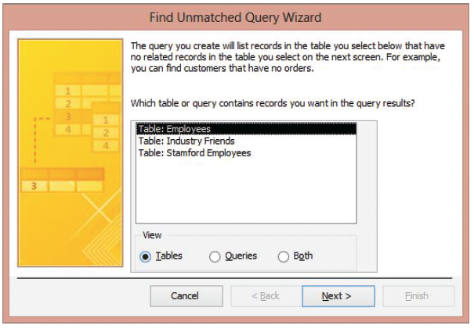
Step by Step: Find Unmatched Records
USE the database that is open from the previous exercise.
On the CREATE tab, in the Queries group, click the Query Wizard button. The New Query dialog box appears.
Click Find Unmatched Query Wizard and then click OK. The Find Unmatched Query Wizard appears, as shown above.

Slide 23
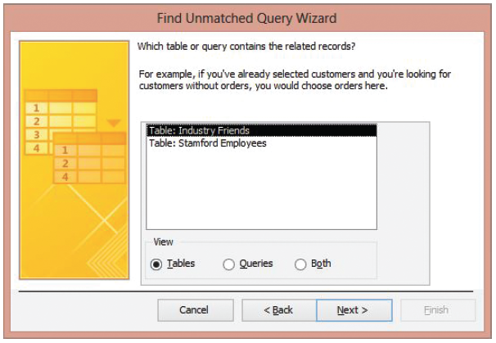
Step by Step: Find Unmatched Records
Table: Employees is the default selection in this screen. This table will contain the records you’ll want to display. Click the Next > button to display the next screen in the Find Unmatched Query Wizard, shown at right.

Slide 24
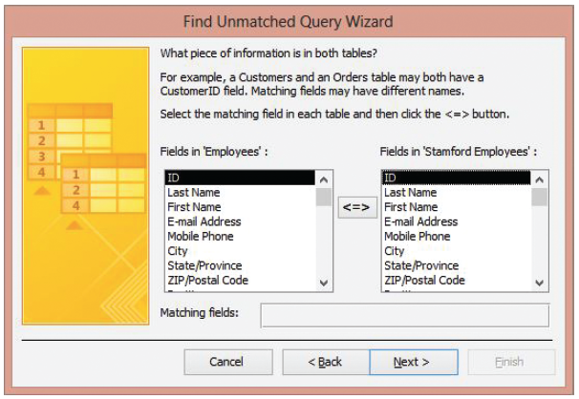
Step by Step: Find Unmatched Records
Select Table: Stamford Employees to select the table that is related to the Employees table and contains the records you don’t want to display. Click the Next > button to display the next screen in the Find Unmatched Query Wizard, shown at right.
Click E-mail Address in the Fields in “Employees” list. Click E-mail Address in the Fields in “Stamford Employees” list. Click the <=> button to display them in the Matching fields box. These fields contain data that is in both tables.

Slide 25
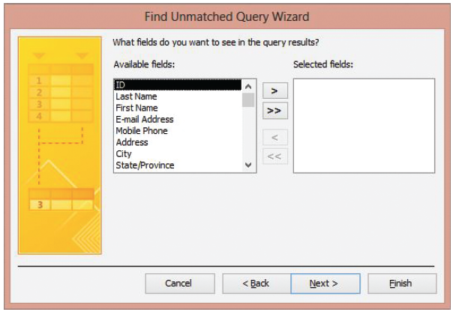
Step by Step: Find Unmatched Records
Click the Next > button to display the next screen in the Find Unmatched Query Wizard, shown at right.
In the Available fields box, double-click Last Name, First Name, Position, and City to move them to the Selected fields box.

Slide 26
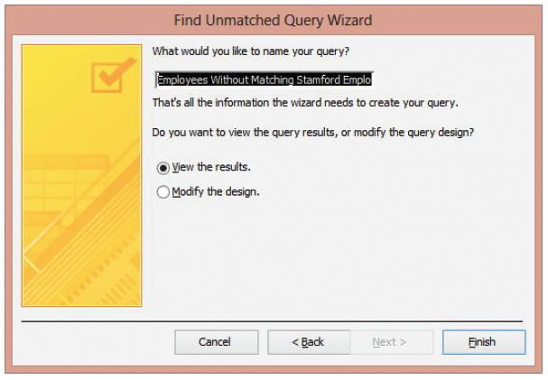
Step by Step: Find Unmatched Records
Click the Next > button to display the final screen in the Find Unmatched Query Wizard, shown at right.

Slide 27
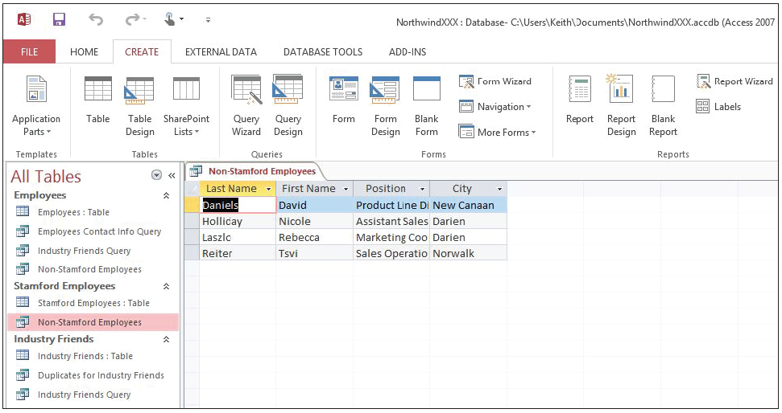
Step by Step: Find Unmatched Records
Click in the text box at the top of this screen and key Non-Stamford Employees to name your query, then click the Finish button. The query is displayed, as shown above.
Click the Close button on the Non-Stamford Employees tab to close the query.
PAUSE. LEAVE the database open to use in the next exercise.

Slide 28
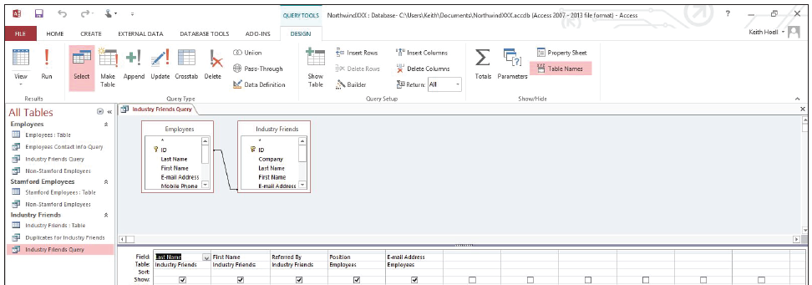
Step by Step: Add a Table to a Query
USE the database that is open from the previous exercise.
Double-click the Industry Friends Query in the Navigation Pane to open it.
On the HOME tab, in the Views group, click the lower half of the View button and then click Design View. The query appears in Design view, as shown below.

Slide 29
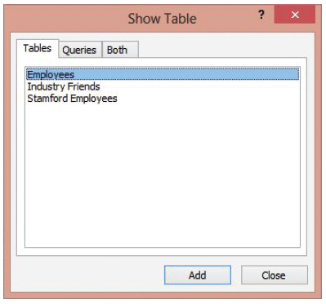
Step by Step: Add a Table to a Query
On the QUERY TOOLS DESIGN tab, in the Query Setup group, click the Show Table button to display the Show Table dialog box, shown at right.

Slide 30
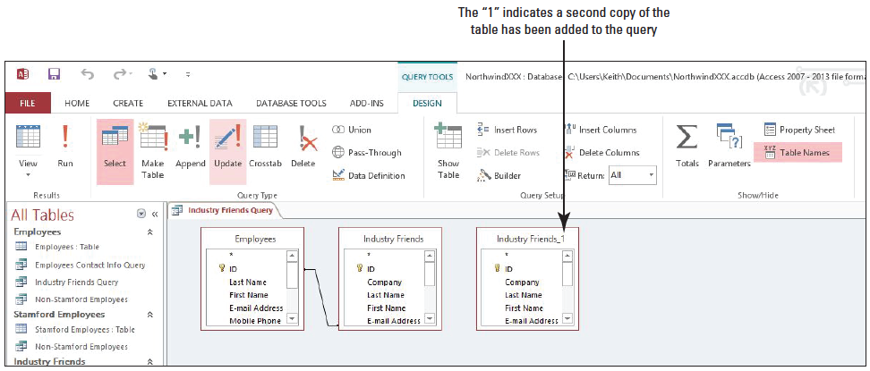
Step by Step: Add a Table to a Query
Click Industry Friends and click the Add button. A second copy of the Industry Friends table is added to the query, as indicated by the “1” in the title, as shown below.

Slide 31
Step by Step: Add a Table to a Query
Click Stamford Employees and click the Add button. The table is added to the query.
Click the Close button in the Show Table dialog box.
PAUSE. LEAVE the database open to use in the next exercise.

Slide 32
Step by Step: Remove a Table from a Query
USE the database that is open from the previous exercise.
Click anywhere in the Industry Friends_1 field list.
[Press the Delete key] to remove the table.
Click anywhere in the Stamford Employees field list.
[Press the Delete key] to remove the table.
Click the Close button on the Industry Friends Query tab to close the query. If a message asks you if you want to save the changes, click Yes.
PAUSE. LEAVE the database open to use in the next exercise.

Slide 33
Step by Step: Add Criteria to a Query
USE the database that is open from the previous exercise.
In the Navigation Pane, double-click the Employees Contact Info Query to open it.
On the HOME tab, in the Views group, click the lower half of the View button and click Design View.

Slide 34
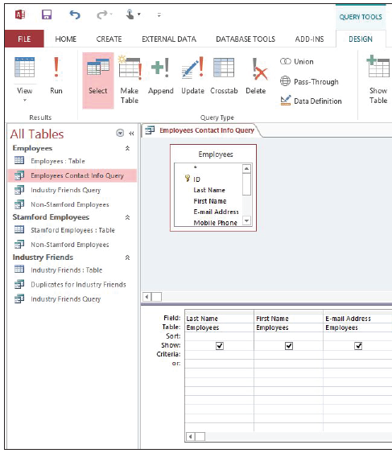
Step by Step: Add Criteria to a Query
In the Criteria row of the Position field, key Like “*Manager” as shown at right to display all records that end with the string “Manager” in the Position field (e.g., Assistant Manager, Sales Manager, Product Manager, etc.).

Slide 35
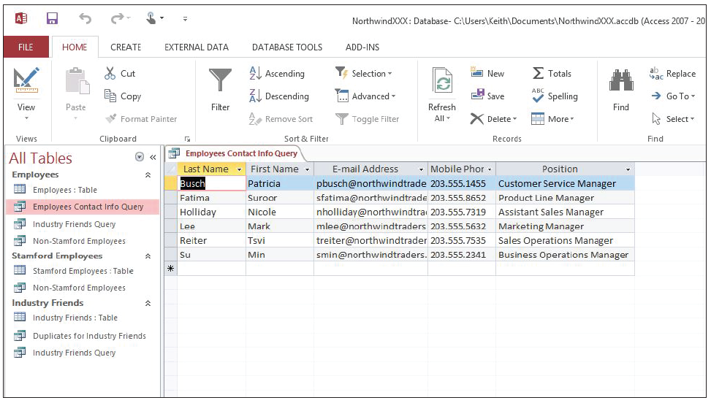
Step by Step: Add Criteria to a Query
On the QUERY TOOLS DESIGN tab, in the Results group, click the lower half of the View button and click Datasheet View. The query results display all records that end with the string “Manager” in the Position field, as shown below.
Notes:
You may have to increase the width of the Position field to completely view the data within it.

Slide 36
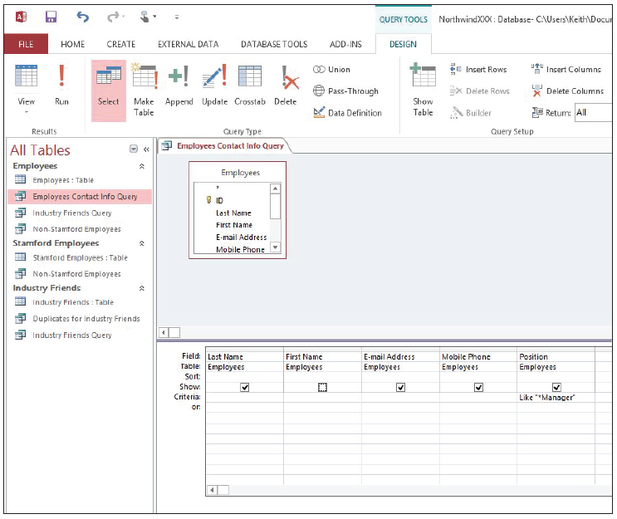
Step by Step: Add Criteria to a Query
On the HOME tab, in the Views group, click the lower half of the View button and click Design View.
In the Show row, under the First Name field, click the Show check box to deselect it, as shown at right. The First Name field data will not appear in the query results.

Slide 37
Step by Step: Add Criteria to a Query
On the HOME tab, in the Views group, click the lower half of the View button and click Datasheet View. Notice that the First Name field doesn’t appear.
Click the Close button on the Employees Contact Info Query tab to close the query. When prompted to save, click Yes.
In the Navigation Pane, double-click the Non-Stamford Employees Query to open it.
On the HOME tab, in the Views group, click the lower half of the View button and click Design View.

Slide 38
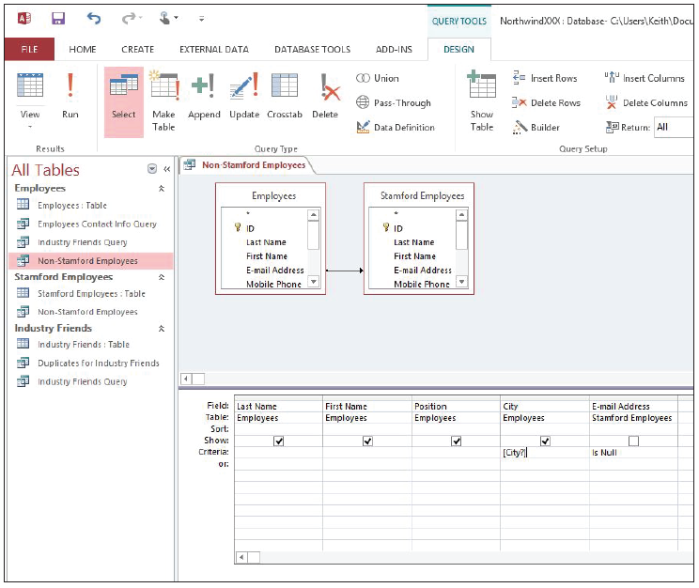
Step by Step: Add Criteria to a Query
In the Criteria row of the City field, key [City?] as shown at right. This will create the parameter and require you to enter a city name when the query is run.

Slide 39
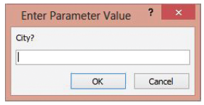
Step by Step: Add Criteria to a Query
On the HOME tab, in the Views group, click the lower half of the View button and click Datasheet View. The prompt appears in the Enter Parameter Value dialog box, as shown below.
Key Darien in the City? box.

Slide 40
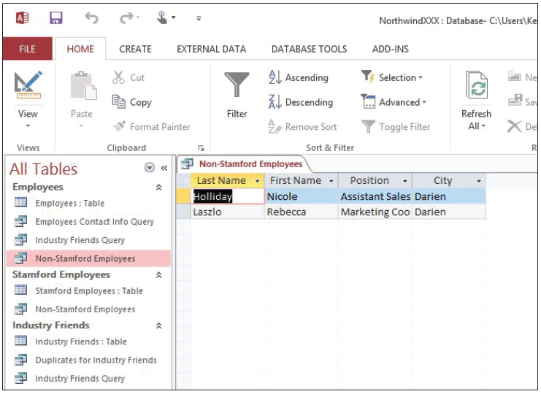
Step by Step: Add Criteria to a Query
Click OK. The records for non-Stamford employees who live in Darien are displayed in the results, as shown at right.

Slide 41
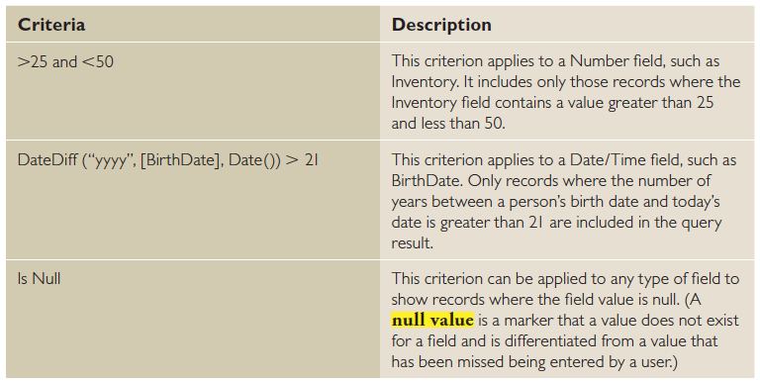
Step by Step: Add Criteria to a Query
Click the Close button on the Non-Stamford Employees tab to close the query. When prompted to save, click Yes.
PAUSE. LEAVE the database open to use in the next exercise.
The table below shows some sample criteria and explains how they work.

Slide 42
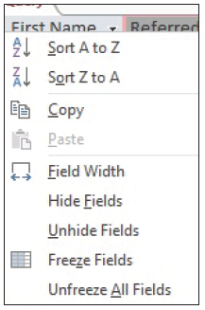
Step by Step: Sort Data within a Query
USE the database that is open from the previous exercise.
In the Navigation Pane, double-click the Industry Friends Query to open it.
Right-click the Referred By field to display the shortcut menu shown at right.

Slide 43
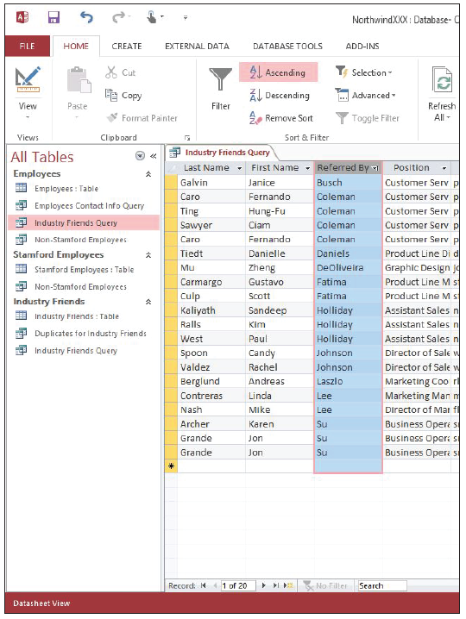
Step by Step: Sort Data within a Query
Click Sort A to Z. The field is sorted in alphabetical order from A to Z, as shown at right.
On the HOME tab, in the Sort & Filter group, click the Remove Sort button. The sort order is removed from the Referred By field.

Slide 44
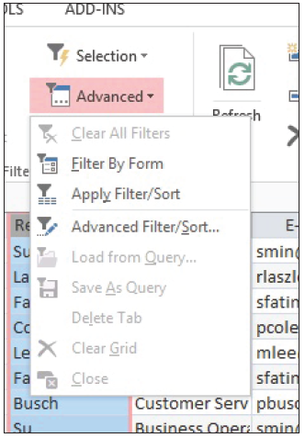
Step by Step: Sort Data within a Query
On the HOME tab, in the Sort & Filter group, click the Advanced button to display the menu shown at right.

Slide 45
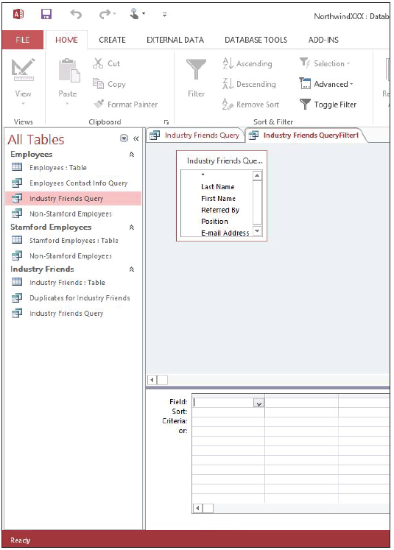
Step by Step: Sort Data within a Query
Click Advanced Filter/Sort. An Industry Friends QueryFilter1 tab appears, as shown at right.
7Click the Field cell in the first column, click the down arrow, and click Referred By on the drop-down menu.

Slide 46
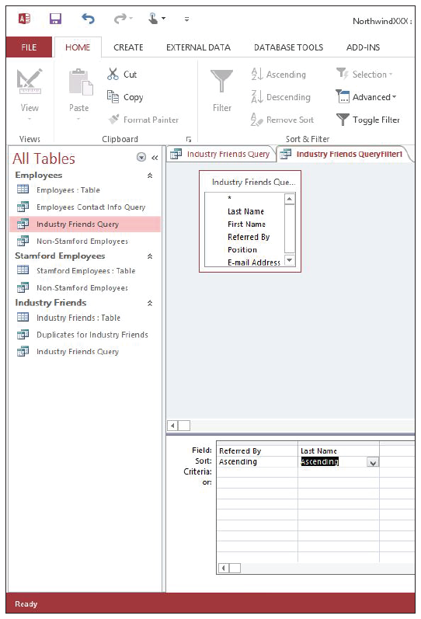
Step by Step: Sort Data within a Query
Click the Sort cell in the first column, click the down arrow, and click Ascending on the drop-down menu.
Click the Field cell in the second column, click the down arrow, and click Last Name on the drop-down menu.
Click the Sort cell in the second column, click the down arrow, and click Ascending on the drop-down menu. Your screen should look similar the figure at right.

Slide 47
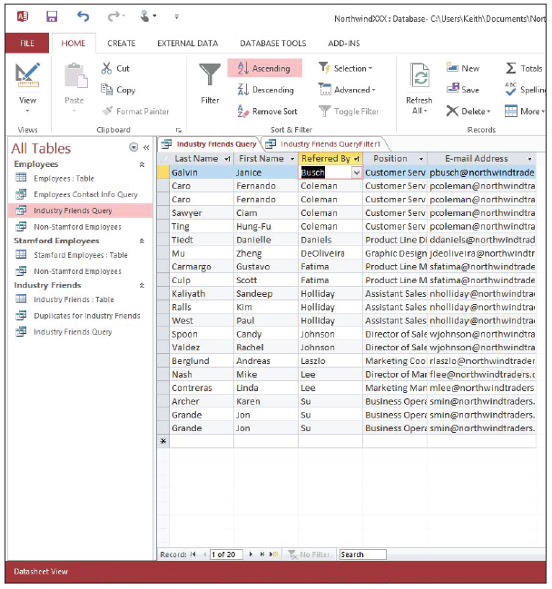
Step by Step: Sort Data within a Query
On the HOME tab, in the Sort & Filter group, click the Advanced button and click Apply Filter/ Sort. The query is sorted by the Referred By field in ascending order and then by the Last Name field in ascending order, as shown at right
On the HOME tab, in the Sort & Filter group, click the Remove Sort button.
PAUSE. LEAVE the database open to use in the next exercise.
Notes:
TAKE NOTE: The same tab is used to perform an advanced filter for the query.

Slide 48
Step by Step: Filter Data within a Query
USE the database that is open from the previous exercise. The Industry Friends Query should be open.
Click the Position header to select the field.
On the HOME tab, in the Sort & Filter group, click the Filter button. A menu appears on the field, as shown at right.

Slide 49
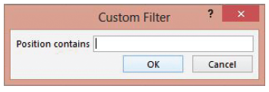
Step by Step: Filter Data within a Query
On the menu, click Text Filters and click Contains on the submenu. A Custom Filter dialog box appears, as shown below.

Slide 50
Step by Step: Filter Data within a Query
In the Position contains box, key Marketing and click OK. The
On the HOME tab, in the Sort & Filter group, click the Toggle Filter button to remove the filter.
Click the Close button on the Industry Friends Query tab to close the query, and click Yes to save changes when prompted.
Click the Close button on the Industry Friends QueryFilter1 tab to close the query.
CLOSE the database.

Slide 51
Skill Summary

